Slide 1
Group 15
Midas Nouwens 920827-T156
Richard Edlund 920213­1836
Emmy Ryrstedt 900527­1284
Adrian Lundhe 821027­0099
Nimer Hammoud 930107­2691
Adventure!

Slide 3
ACME
Visual Merchandise Portal
You forgot to fill in a username and/or password!
An email with your login details has been sent!
patricd@acme.se
*******
username
password
Login
Forgot username/password
Q
W
E
R
T
Y
U
I
O
P
A
S
D
F
G
H
J
K
L
return
Z
X
C
V
B
N
M
@
.
New email!
ACME username and password
.?123

Slide 4
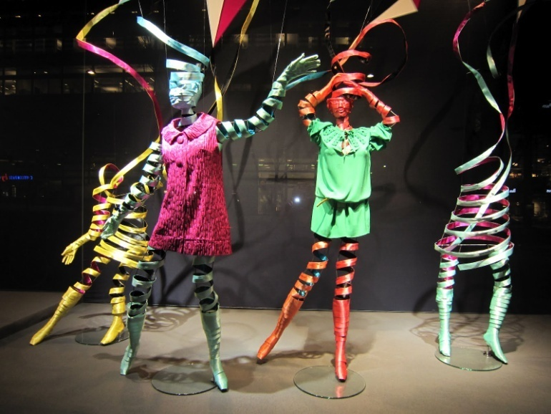
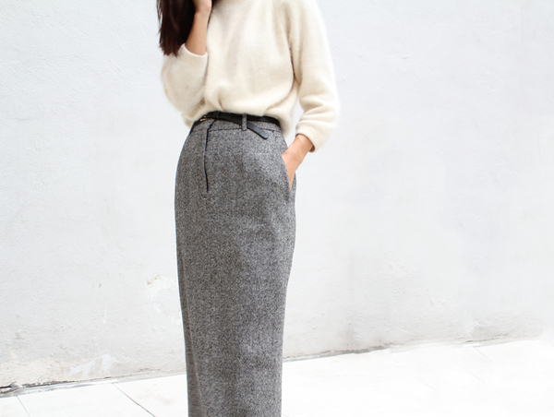
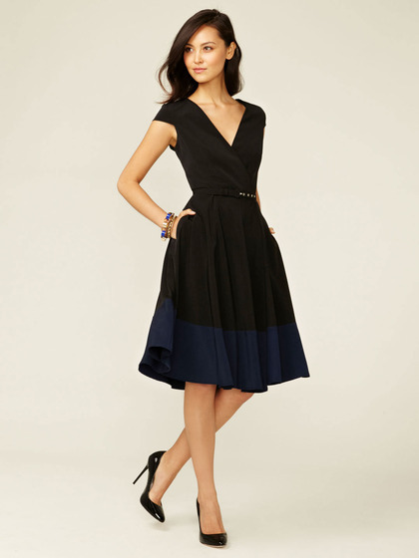
4G
7:11 PM
Newsfeed
Newsfeed
Assignments
10-09-2014
NEW PICTURES ADDED TO LOOKBOOK
Lookbook
Moodboard
Chat
Partners
07-09-2014
NEW ASSIGNMENT:
Camera
Webstore
Buy Christmas decoration
45 days remaining…
Logout

Slide 5
4G
7:11 PM
Assignments
Newsfeed
Dress mannequin
15-07-2015
Assignments
1 day remaining…
Lookbook
Buy Christmas decoration
25-09-2015
Moodboard
45 days remaining…
Chat
Partners
Camera
Webstore
Logout

Slide 6
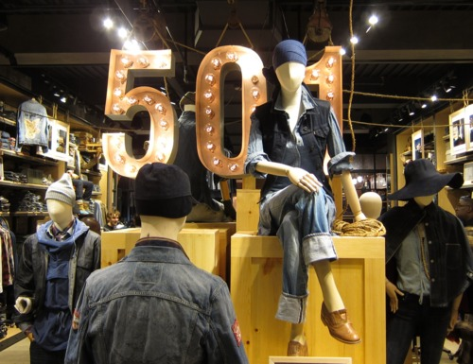
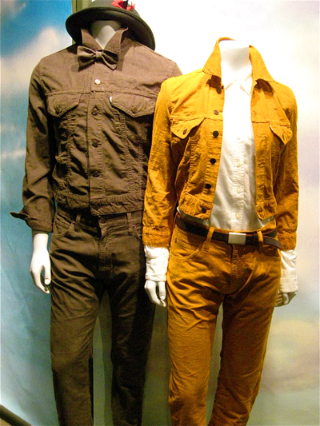
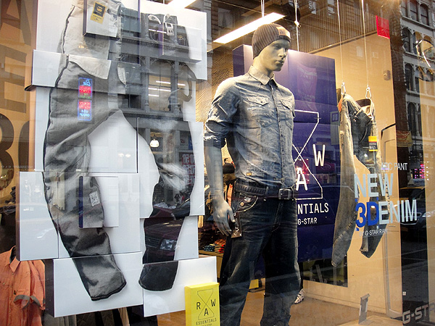
4G
7:11 PM
Dress mannequin
Newsfeed
Please redress the mannequins in the Vintage section. Make sure to emphasize our new jeans collection by using this season’s colours and different textures.
Here are some examples from our Solna store:
Assignments
Lookbook
Moodboard
Chat
Partners
Camera
Webstore
Logout

Slide 7
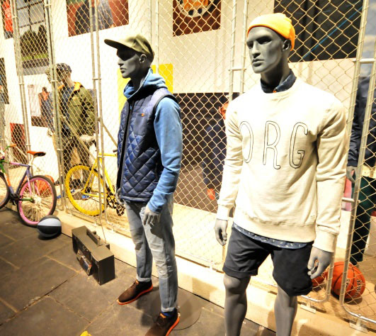
Deadline: 15-07-2015
1 day remaining…
Submit pictures

Slide 8
Newsfeed
Assignments
Lookbook
Moodboard
Chat
Partners
Camera
Webstore
Logout

Slide 9
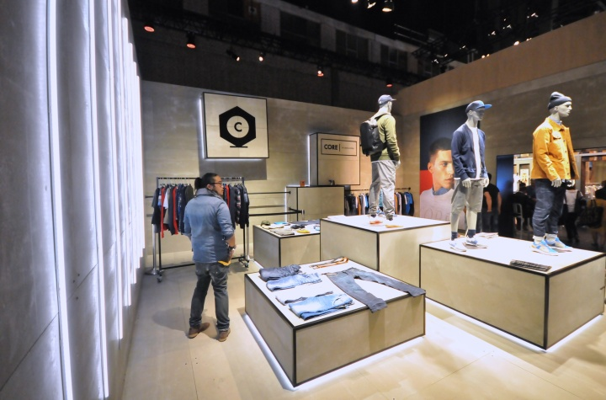

Slide 10
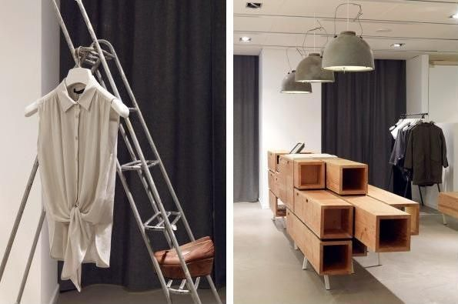
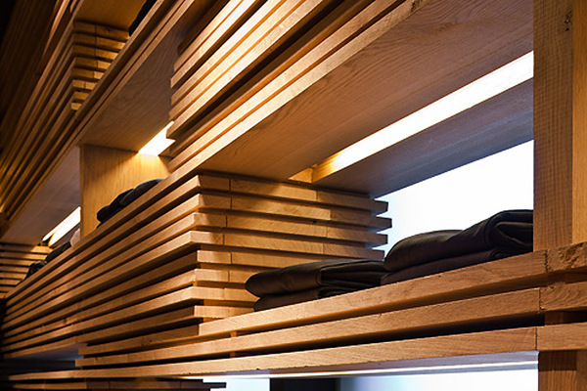
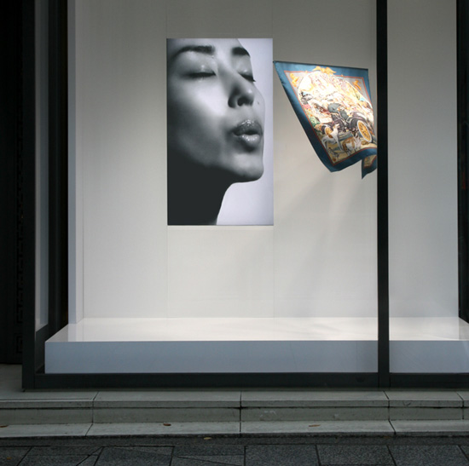
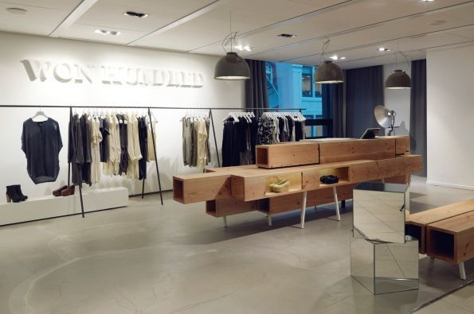
4G
7:11 PM
Moodboard

Slide 11
Deadline: 15-07-2015
1 day remaining…
Submit pictures
Submit!

Slide 12
4G
7:11 PM
Moodboard

Slide 13
Deadline: 15-07-2015
1 day remaining…
Submit pictures
Submit!

Slide 14
Newsfeed
Assignments
Lookbook
Moodboard
Chat
Partners
Camera
Webstore
Logout

Slide 16
Deadline: 15-07-2015
1 day remaining…
Submit pictures
Submit!

Slide 17
4G
7:11 PM
Assignments
Newsfeed
Dress mannequin
15-07-2015
Assignments
Waiting for evaluation!
Lookbook
Buy Christmas decoration
25-09-2015
Moodboard
45 days remaining…
Chat
Partners
Camera
Webstore
Logout

Slide 18
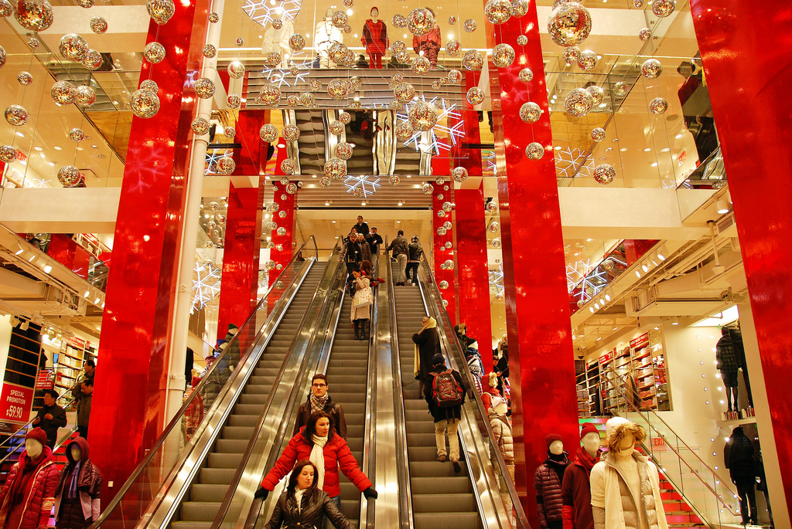
4G
7:11 PM
Buy Christmas decoration
Newsfeed
Christmas is coming up and we want to make our stores look more festive. You’re free to buy the Christmas decoration we’ve added to the webstore or find other things.
Some pictures for reference:
Assignments
Lookbook
Moodboard
Chat
Partners
Camera
Webstore
Logout

Slide 19
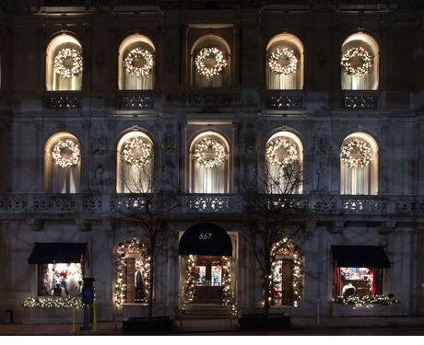
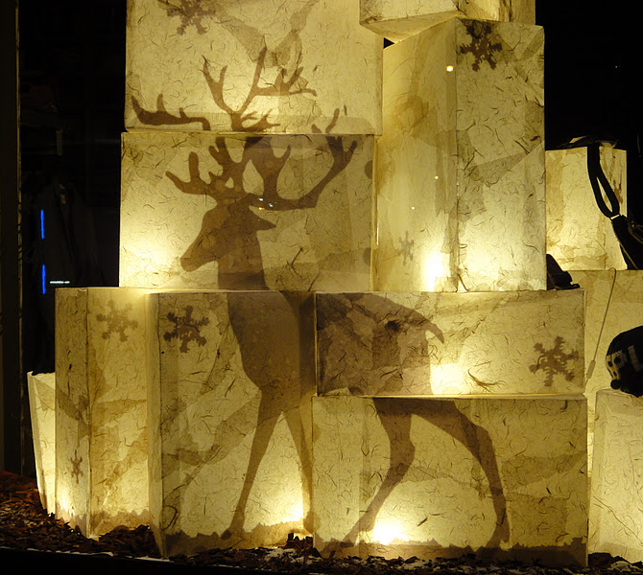
Deadline: 25-09-2015
45 days remaining…
Submit pictures

Slide 20
Newsfeed
Assignments
Lookbook
Moodboard
Chat
Partners
Camera
Webstore
Logout

Slide 21


Slide 22
4G
7:11 PM
Moodboard

Slide 23
Deadline: 25-09-2015
45 days remaining…
Submit pictures
Submit!

Slide 24
4G
7:11 PM
Moodboard

Slide 25
Deadline: 25-07-2015
45 days remaining…
Submit pictures
Submit!

Slide 26
Newsfeed
Assignments
Lookbook
Moodboard
Chat
Partners
Camera
Webstore
Logout

Slide 28
Deadline: 15-07-2015
1 day remaining…
Submit pictures
Submit!

Slide 29
4G
7:11 PM
Assignments
Newsfeed
Dress mannequin
15-07-2015
Assignments
1 day remaining…
Lookbook
Buy Christmas decoration
25-09-2015
Moodboard
Waiting for evaluation!
Chat
Partners
Camera
Webstore
Logout

Slide 30


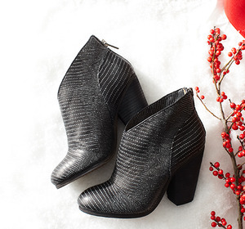
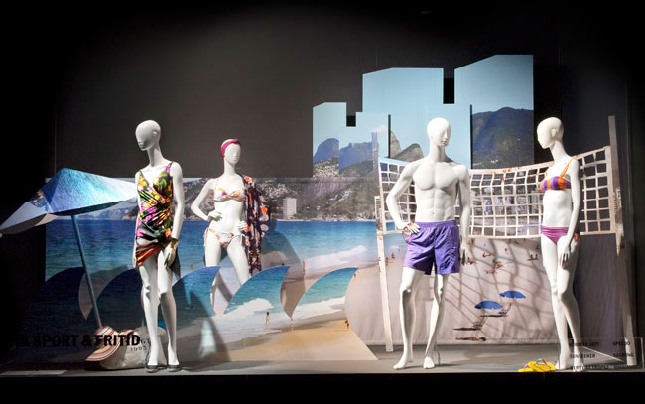
4G
7:11 PM
Lookbook
Newsfeed
Assignments
Lookbook
Moodboard
Chat
Partners
Camera
Webstore
Removed from moodboard!
Removed from moodboard!
Removed from moodboard!
Removed from moodboard!
Removed from moodboard!
Removed from moodboard!
Added to moodboard!
Added to moodboard!
Added to moodboard!
Added to moodboard!
Added to moodboard!
Added to moodboard!

Slide 31
4G
7:11 PM
Lookbook

Slide 32
4G
7:11 PM
Lookbook

Slide 33
4G
7:11 PM
Lookbook

Slide 34
4G
7:11 PM
Lookbook

Slide 35
4G
7:11 PM
Lookbook

Slide 36
4G
7:11 PM
Lookbook

Slide 37
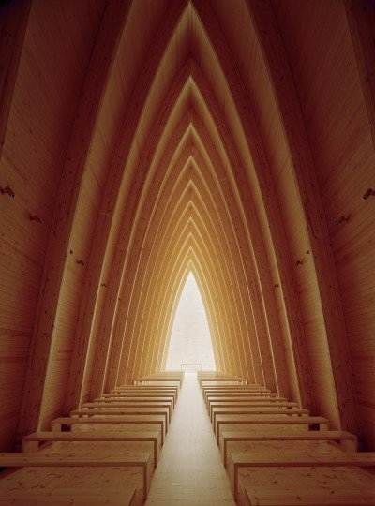




4G
7:11 PM
Moodboard
Lookbook
Newsfeed
Lookbook
Pictures
Assignments
Lookbook
Moodboard
Chat
Partners
Camera
Webstore
Logout

Slide 38
4G
7:11 PM
Moodboard
Lookbook
Newsfeed
Lookbook
Pictures
Assignments
Lookbook
Moodboard
Chat
Partners
Camera
Webstore
Logout

Slide 40
4G
7:11 PM
Moodboard
Lookbook
Newsfeed
Lookbook
Pictures
Undo
Assignments
Lookbook
Moodboard
Chat
Partners
Camera
Webstore
Logout

Slide 41
4G
7:11 PM
Moodboard
Lookbook

Slide 42
4G
7:11 PM
Moodboard
Lookbook

Slide 43
4G
7:11 PM
Moodboard
Lookbook

Slide 44
4G
7:11 PM
Moodboard
Lookbook

Slide 45
4G
7:11 PM
Moodboard
Inspiration

Slide 46
4G
7:11 PM
Moodboard
Pictures
Newsfeed
Lookbook
Pictures
Assignments
Lookbook
Moodboard
Chat
Partners
Camera
Webstore
Logout

Slide 47
4G
7:11 PM
Moodboard
Pictures

Slide 48
4G
7:11 PM
Moodboard
Pictures

Slide 49
4G
7:11 PM
Moodboard
Pictures

Slide 50
4G
7:11 PM
Moodboard
Pictures

Slide 51
4G
7:11 PM
Moodboard
Pictures

Slide 52
4G
7:11 PM
Chat
Newsfeed
Vera Planet
Assignments
Nick Frost
Lookbook
Peter Klus
Moodboard
Nicky Fer
You must select someone to chat with first!
Cindy Zijlstra
Chat
Tanne Baum
Partners
Camera
Webstore
Logout

Slide 53
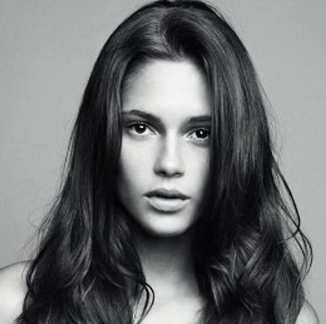

4G
7:11 PM
Vera Planet
Newsfeed
Vera Planet
Vera Planet
Assignments
Nick Frost
Nick Frost
Lookbook
Peter Klus
Peter Klus
Moodboard
Nicky Fer
Nicky Fer
Cindy Zijlstra
Cindy Zijlstra
Chat
Tanne Baum
Tanne Baum
Partners
Camera
Webstore
Logout

Slide 54
Newsfeed
Assignments
Lookbook
Moodboard
Chat
Partners
Camera
Webstore
Logout

Slide 55


Slide 56

4G
7:11 PM
Vera Planet
Newsfeed
Vera Planet
Vera Planet
Assignments
Nick Frost
Nick Frost
Lookbook
Peter Klus
Peter Klus
Moodboard
Nicky Fer
Nicky Fer
Cindy Zijlstra
Cindy Zijlstra
Chat
Tanne Baum
Tanne Baum
Partners
Camera
Webstore
Logout

Slide 57
4G
7:11 PM
Moodboard
Inspiration
Inspiration
Pictures

Slide 58
4G
7:11 PM
Moodboard
Pictures
Inspiration
Pictures

Slide 59
4G
7:11 PM
Vera Planet
Newsfeed
Vera Planet
Vera Planet
Assignments
Nick Frost
Nick Frost
Lookbook
Peter Klus
Peter Klus
Moodboard
Nicky Fer
Nicky Fer
Cindy Zijlstra
Cindy Zijlstra
Chat
Tanne Baum
Tanne Baum
Partners
Camera
Webstore
Logout

Slide 60
4G
7:11 PM
Vera Planet
Newsfeed
Vera Planet
Vera Planet
Assignments
Nick Frost
Nick Frost
Lookbook
Peter Klus
Peter Klus
Moodboard
Nicky Fer
Nicky Fer
Cindy Zijlstra
Cindy Zijlstra
Chat
Tanne Baum
Tanne Baum
Partners
Camera
Webstore
Logout

Slide 61

4G
7:11 PM
Nick Frost
Newsfeed
Vera Planet
Vera Planet
Assignments
Nick Frost
Nick Frost
Lookbook
Peter Klus
Peter Klus
Moodboard
Nicky Fer
Nicky Fer
Cindy Zijlstra
Cindy Zijlstra
Chat
Tanne Baum
Tanne Baum
Partners
Camera
Webstore
Logout

Slide 62

4G
7:11 PM
Peter Klus
Newsfeed
Vera Planet
Vera Planet
Assignments
Nick Frost
Nick Frost
Lookbook
Peter Klus
Peter Klus
Moodboard
Nicky Fer
Nicky Fer
Cindy Zijlstra
Cindy Zijlstra
Chat
Tanne Baum
Tanne Baum
Partners
Camera
Webstore
Logout

Slide 63
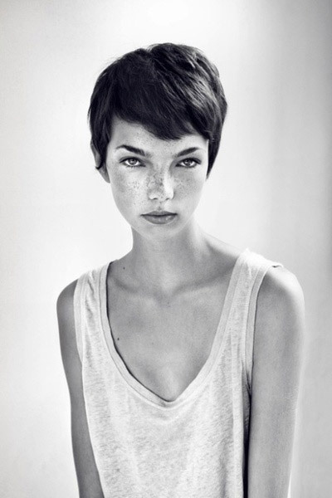
4G
7:11 PM
Nicky Fer
Newsfeed
Vera Planet
Vera Planet
Assignments
Nick Frost
Nick Frost
Lookbook
Peter Klus
Peter Klus
Moodboard
Nicky Fer
Nicky Fer
Cindy Zijlstra
Cindy Zijlstra
Chat
Tanne Baum
Tanne Baum
Partners
Camera
Webstore
Logout

Slide 64

4G
7:11 PM
Cindy Zijlstra
Newsfeed
Vera Planet
Vera Planet
Assignments
Nick Frost
Nick Frost
Lookbook
Peter Klus
Peter Klus
Moodboard
Nicky Fer
Nicky Fer
Cindy Zijlstra
Cindy Zijlstra
Chat
Tanne Baum
Tanne Baum
Partners
Camera
Webstore
Logout

Slide 65

4G
7:11 PM
Tanne Baum
Newsfeed
Vera Planet
Vera Planet
Assignments
Nick Frost
Nick Frost
Lookbook
Peter Klus
Peter Klus
Moodboard
Nicky Fer
Nicky Fer
Cindy Zijlstra
Cindy Zijlstra
Chat
Tanne Baum
Tanne Baum
Partners
Camera
Webstore
Logout

Slide 66
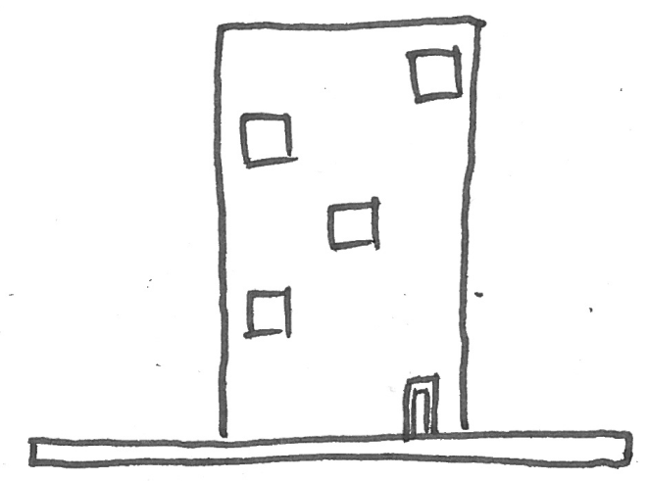
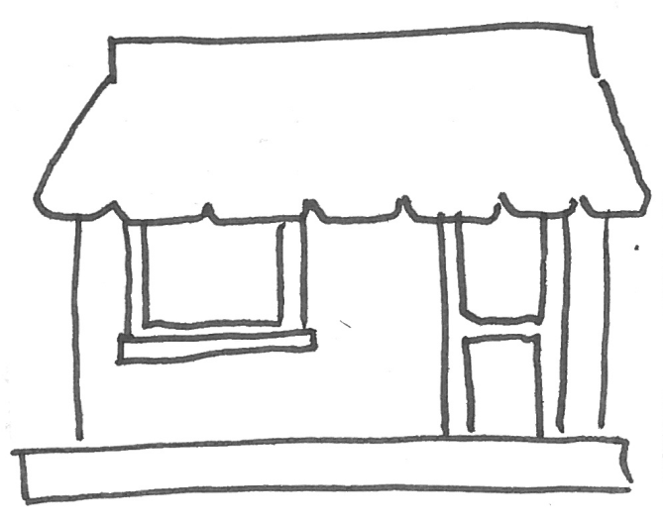
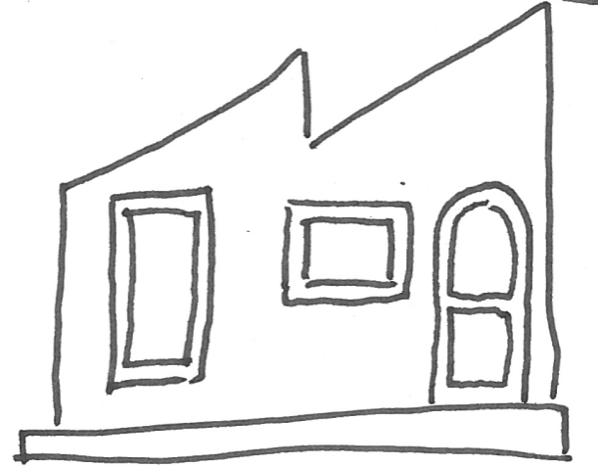
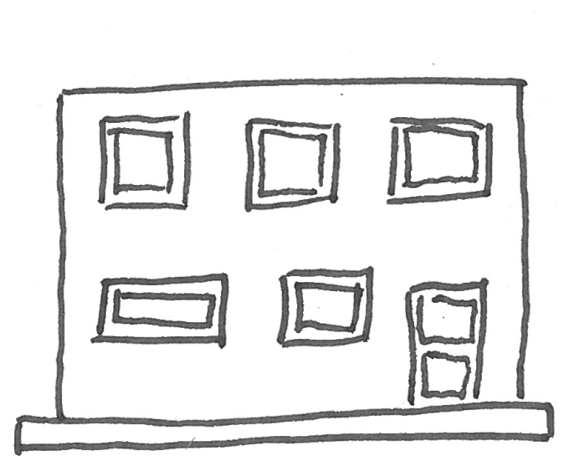
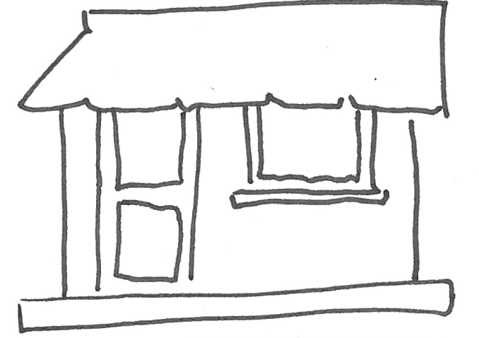
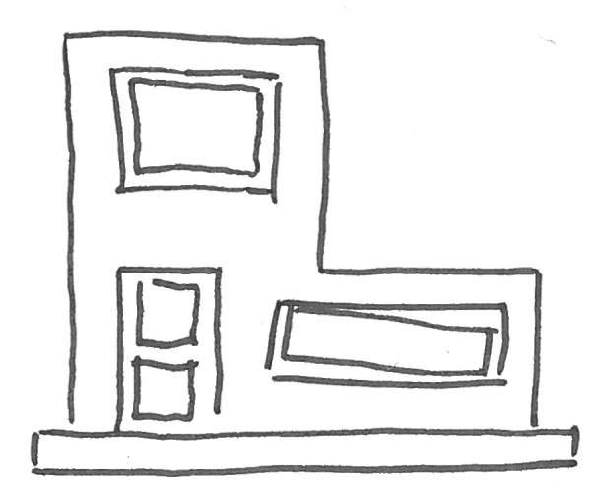
4G
7:11 PM
Partners
Newsfeed
Assignments
Lookbook
Moodboard
ACME HQ
ACME Östermalm
ACME Solna
Chat
Partners
Camera
Webstore
ACME Farsta
ACME Sundyburg
ACME Kista
Logout

Slide 67
4G
7:11 PM
ACME HQ
Newsfeed
Assignments
Lookbook
Moodboard
Valhallavägen 12
Stockholm, 98732
070 – 752 86 73
Mon - Fri: 09:00 – 21:00
Sat – Sun: 09:00 – 18:00
Chat
Partners
Vera Planet
Camera
070 – 483 25 77
Webstore
Online
Logout

Slide 68
4G
7:11 PM
ACME Östermalm
Newsfeed
Assignments
Lookbook
Moodboard
Shallavägen 12
Stockholm, 98732
070 – 752 86 73
Mon - Fri: 09:00 – 21:00
Sat – Sun: 09:00 – 18:00
Chat
Partners
Nicky Fer
Camera
070 – 483 25 77
Webstore
Offline
Logout

Slide 69

4G
7:11 PM
ACME Solna
Newsfeed
Assignments
Lookbook
Moodboard
Smalallavägen 12
Stockholm, 98732
070 – 752 86 73
Mon - Fri: 09:00 – 21:00
Sat – Sun: 09:00 – 18:00
Chat
Partners
Cindy Zijlstra
Camera
070 – 483 25 77
Webstore
Offline
Logout

Slide 70
4G
7:11 PM
ACME Farsta
Newsfeed
Assignments
Lookbook
Moodboard
Kahallavägen 12
Stockholm, 98732
070 – 752 86 73
Mon - Fri: 09:00 – 21:00
Sat – Sun: 09:00 – 18:00
Chat
Partners
Nick Frost
Camera
070 – 483 25 77
Webstore
Online
Logout

Slide 71
4G
7:11 PM
ACME Sundyburg
Newsfeed
Assignments
Lookbook
Moodboard
Trallavägen 12
Stockholm, 98732
070 – 752 86 73
Mon - Fri: 09:00 – 21:00
Sat – Sun: 09:00 – 18:00
Chat
Partners
Tanne Baum
Camera
070 – 483 25 77
Webstore
Offline
Logout

Slide 72
4G
7:11 PM
ACME Kista
Newsfeed
Assignments
Lookbook
Moodboard
Balallavägen 12
Stockholm, 98732
070 – 752 86 73
Mon - Fri: 09:00 – 21:00
Sat – Sun: 09:00 – 18:00
Chat
Partners
Peter Klus
Camera
070 – 483 25 77
Webstore
Offline
Logout

Slide 73
Newsfeed
Assignments
Lookbook
Moodboard
Chat
Partners
Camera
Webstore
Logout

Slide 75



4G
7:11 PM
Webstore
Newsfeed
New
Assignments
Lookbook
Moodboard
Chat
Vintage globe
Decorated mannequins
Number lamp
200 SEK
500 SEK
150 SEK
Partners
Camera
Webstore
Logout

Slide 76
4G
7:11 PM
Vintage globe
Newsfeed
Assignments
A vintage globe of planet Earth. Goes well with our Vintage collection and other items with a brown/pastel tint.
Lookbook
Moodboard
30 x 17.8 cm
Plastic and wood
Chat
200 SEK
Partners
Camera
Item added to your shopping cart!
Webstore
Logout

Slide 77
4G
7:11 PM
Decorated mannequins
Newsfeed
Assignments
Six female mannequins with various types of geometric patterns. Goes well with the new autumn collection.
Lookbook
Moodboard
200 x 40 x 25 cm
Cotton, metal, and tempex
Chat
500 SEK
Partners
Camera
Item added to your shopping cart!
Webstore
Logout

Slide 78
4G
7:11 PM
Number lamp
Newsfeed
Assignments
A lamp with decreased density cutouts of numbers to give a texture kind of light. Great for illuminating corners without being too bright
Lookbook
Moodboard
25 x 25 cm
Plastic
Chat
150 SEK
Partners
Camera
Item added to your shopping cart!
Webstore
Logout

Slide 79
4G
7:11 PM
Shopping cart
Newsfeed
Assignments
Lookbook
Moodboard
Chat
Vintage globe
Number lamp
200 SEK
150 SEK
Partners
Camera
Total: 350 SEK
Webstore
Logout

Slide 80
4G
7:11 PM
Shopping cart
Newsfeed
Assignments
Lookbook
Moodboard
Your shopping cart is empty
Chat
Partners
Camera
Webstore
Logout

Slide 81
4G
7:11 PM
Newsfeed
Assignments
Lookbook
Items purchased!
Moodboard
Chat
Back to webstore
Partners
Camera
Webstore
Logout

